Slide 1
Welcome to 5th grade
Curriculum night with ms. mcnally

Slide 2
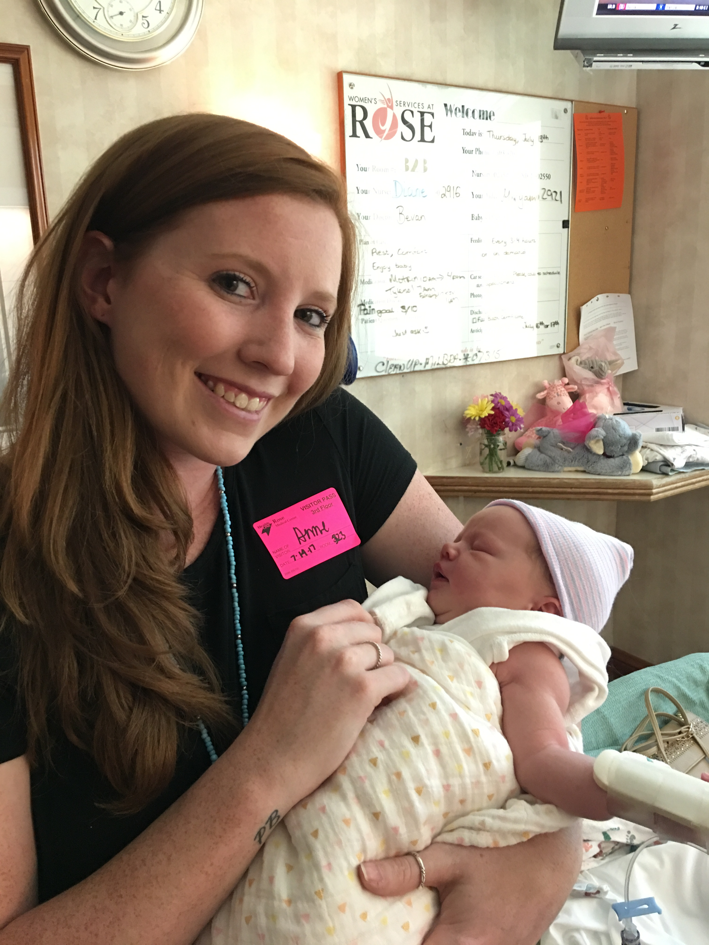
To start…..about the teacher
My name is Anne McNally, and this will be my 3rd year teaching. I am 25 years old. I graduated from the University of Northern Colorado in 2014 with a Bachelor’s Degree in Elementary Education. I am currently a grad student at UNC, where I am studying literacy. I grew up in Colorado, and have been in Jefferson County Public Schools since Kindergarten. I love being active and being outdoors. You can see me skiing in the winter and camping in the summer!
No, this is not my child. This is Ellie, my 2 month old niece! Had to share because she is adorable.

Slide 3
Daily schedule
8:50-9:00 Get ready for the day!
9:00 Bell Rings
9:00-9:05 Morning routine
9:05-9:50 Art, Music, or P.E.
9:50-10:15 W.I.N. (What I Need)
10:20-12:15 Literacy
12:15-12:40 Recess
12:40-1:00 Lunch
1:00-2:30 Math
2:30-2:45 Outdoor Enrichment
2:45-3:30 Science/Social Studies
3:35 Dismissal
OTHER SCHEDULE ADDITIONS:
Makerspace- Tuesdays 1:25-2:25
Library- Wednesdays 2:45-3:15
REMINDER:
THERE IS NO SCHOOL ON NOVEMBER 3RD, FEBURARY 16TH, AND MARCH 16TH NOW.
SEPTEMBER 22ND AND APRIL 27TH STILL REMAIN EARLY RELEASE DAYS

Slide 4
What is….makerspace? What is ….outdoor enrichment?
Outdoor Enrichment!
This will be 15 minutes a day.
During this time, students will be able to do more learning outdoors, explore nature, but also be kids (running, chasing, relaxing, etc.)
It has been proven that having an addition “recess” is considered a best practice in education.
Makerspace!
Every grade gets an hour a week to involved in Makerspace.
Students can build, create, destroy, experiment, learn, etc. in our new Makerspace room (the temp outside).
Some days will include specific lessons that help students build those collaboration skills, following direction skills, and exposing their minds to new things; other days it will include them exploring on their own and making new creations..
https://www.youtube.com/watch?v=NLEJLOB6fDw

Slide 5
Now with the fun stuff! What they will be learning!
Math
Literacy- Reading and Writing
Science
Social Studies

Slide 6
Literacy- Reading and writing
Our main goal as a school this year is to focus on literacy.
W.I.N. (What I Need) is going to be Literacy Intervention time.
We will be using the Lucy Calkins Units of Study for part of our literacy instruction.
Literacy Instruction will be a mixture of whole group reading, small group reading, reading intervention, specific reading strategy instruction, and eventually we will be rotating between classrooms for literacy instruction.
Reading Logs
These will be given out once a month. Four nights a week, each student needs to read 30 minutes. This sheet will have a specific due date on the top of each sheet. This makes sure the student is accountable for their own reading. Parents will need to sign this sheet quite often.
Writing- We will be focusing on informational, explanatory, narrative, and persuasive writing. At the end of the year, there will be a writing portfolio where they will use every form of writing they have learned and make a big collection!

Slide 7
Math
In math, we use Math Expressions for 5th grade.
This will include:
Adding and subtracting fractions
Adding and subtracting with decimals
Multiplication and division with fractions
Multiplication and division with whole numbers and decimals
Area and volume
Operations and word problems
Algebra, patterns, and coordinate graphs
Measurement and data
We will do whole class instruction, math workshop, and math groups. There will be End-of-Unit tests, and quizzes throughout the unit to see where we need to focus.

Slide 8
Social Studies and Science
Social Studies
The “Roots” of America: Emergence of a New Nation
The American Revolution
The United States Constitution
Service of Financial Institutions
Young Ameritowne
Science
Sifting, Sorting, Separating
Beach or Blizzard?
Wind, Water, and Ice: Moving Mountains
Natural Resources: Xcel Energy kits
The Creature Connection: Systems for Success
Growing and Changing: March 15th is the parent meeting

Slide 9
Homework
5th Grade Homework Responsibilities:
Reading Logs
Book Reports- 2 or 3 a year
Very rarely- Homework/Remembering math sheets
Personally, I believe the best practice comes from inside the classroom. Time at home is the opportunity for children to spend time with their families and play.

Slide 10
Other Responsibilities
Student Planners
Husky Folders
We will fill out planners every single day. This will include important dates to remember, book reports, field trips, special events, etc.
I do not need a signature from you every night after checking their planner.
It will be checked before they leave school.
These are given out every Friday.
They may have graded work in them, or important papers and/or flyers.

Slide 11
Grading
4 (Exceeding Grade Level)
Student consistently exceeds grade-level content standards and expectations
3 (Meeting Standard)
Student consistently demonstrates grade-level content standards and expectations
2 (Progressing toward Standard)
Student is working towards the grade level content standards and expectations, but has not been able to consistently demonstrate the grade-level content standards and expectations
1 (Not meeting Standard)
Student consistently does not demonstrate content standards and expectations, and therefore requires extra support and intervention to reach grade level content standards and expectations.

Slide 12
Testing
MAP (Measure of Academic Progress)- three times a year
PARCC and CMAS (Spring)
Unit tests for each subject

Slide 13
Field TRIPS
Young Ameritowne
Denver Museum of Nature and Science

Slide 14
Water bottles and snack
Water bottles and snack are allowed in my classroom.
Snack is eaten during our literacy time.
No candy please.
Healthy options.
Water bottles should only have water in them, nothing else.
I don’t want a giant red stain on my carpet….again.
I would prefer they bring one so they do not need to leave the classroom multiple times.

Slide 15
Birthdays and Parties
Birthday treats are allowed. Please be aware that there may be allergies in the classroom. Legally, I can’t tell you what they are.
Parties: Halloween, Holliday, Valentine’s Day, and End-of-Year (run by me)
We are also working on being a heathier school. At parties, at least half of the food needs to be healthy.

Slide 16
Classroom ticket store
To help encourage positive behavior, I give out tickets on a regular basis.
These tickets can be used to make purchases in my classroom.
Electronic day (with your permission)
Gum for a week (with your permission)
Lunch with me and a friend
Teacher for a subject
Quit job
Trade job
I do not give out candy for positive behavior. We are trying to become a healthier school!

Slide 17
Toys
Don’t let your child bring them to school.
Fidget spinners are currently allowed…..until it becomes a problem. Please have their name on it.

Slide 18
Contact information
My email is Anne.McNally@jeffco.k12.co.us
You may call the school to get my classroom phone.
Emails and voicemails always come to my cell phone, so I will be able to respond quickly.
I try not to check emails once I am home….but may happen on occasion.

Slide 19
Any questions?

Slide 20
Thank you for coming!!!

